Slide 1
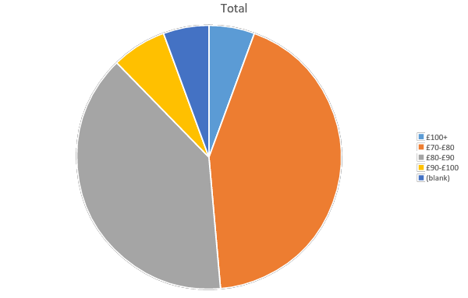

In the last 12 months what is the highest hourly rate for emergency (<2 days notice) locum work you’ve received?
Are you being paid fairly?

Slide 2
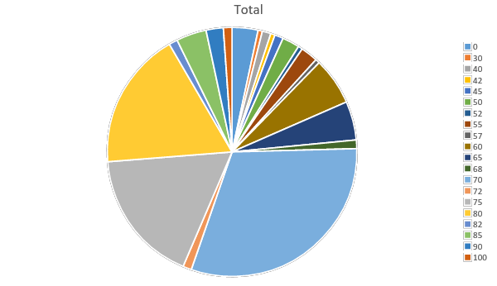
In the last 12 months what is the lowest hourly rate for emergency (<2 days notice) locum work you’ve received?
Are you being paid fairly?

Slide 3
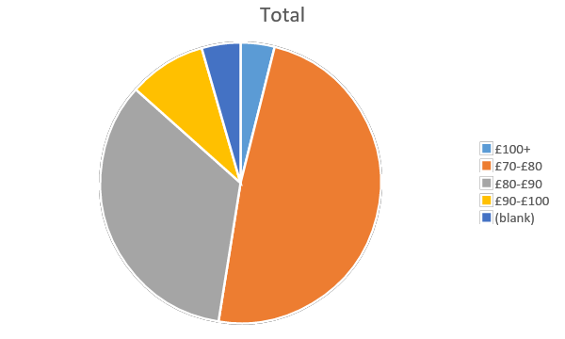
In the last 12 months what is the highest hourly rate for regular (>2 days notice) locum work that you received?
Are you being paid fairly?

Slide 4
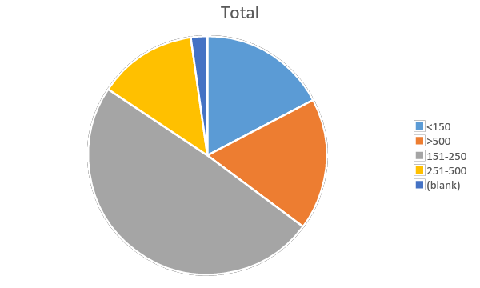
How much money do you earn per session?
Did you know that 30% of NL locums earn more than £500 per session vs 13% of non NL locums?
Are you being paid fairly?

Slide 5
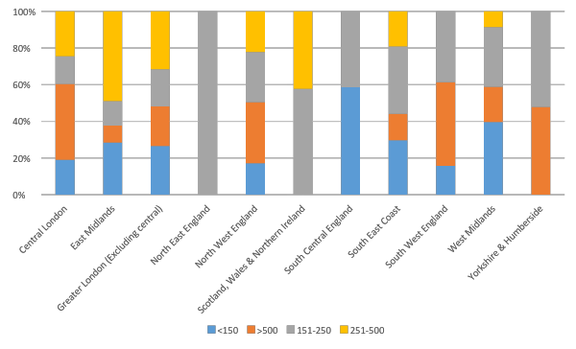
How much money do you earn per session?
By region
Are you being paid fairly?

Slide 6
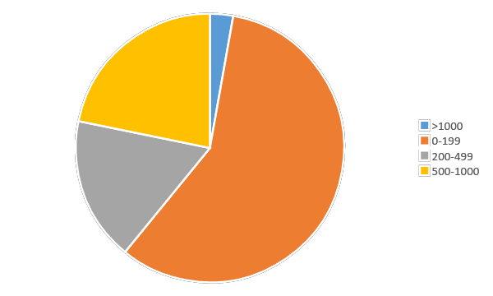
How much money do you spend on CPD per year?
Are you being paid fairly?

